Slide 1

Stock Market Forecasting Using NLP
Presented By: Jyothsna Aitipamula Vaishnavi sai Malapati Sai Deekshith Miyapuram

Slide 2
Project Objective
The stock market prices change every day by market forces (supply and demand)and as well as news
In recent years stock market predictions using NLP have become one of the reliable approaches to make decisions on particular stock.
This project is about analyzing twitter news data about Apple Inc. and predicting its future stock trend with sentiment classification.
So, we used BERT model to find the sentiment between tweets and their affect on stock prices for investor based decisions.
We also used a LSTM model which is built upon RNN to find the co-relation between “public sentiment” and “market trends”.

Slide 3
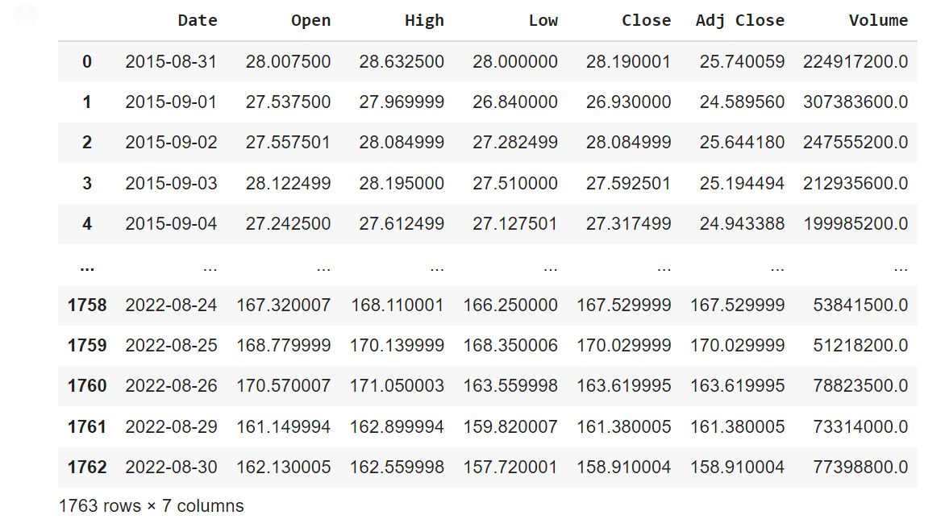
Dataset
In this project we used two main datasets .
APPLE company stocks which are taken from Kaggle.
https://www.kaggle.com/datasets/berkayalan/apple-stock-data-between-2015-and-2022?resource=download\
Features: opening ,closing, highest, lowest price on particular date

Slide 4
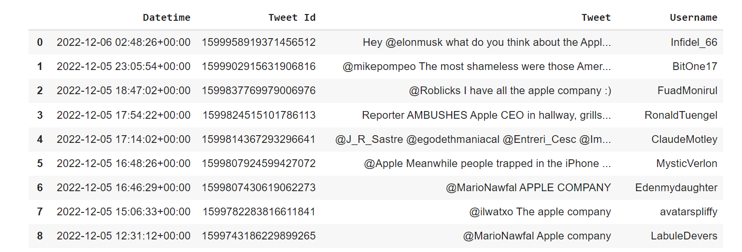
APPLE company Tweets Dataset:
https://drive.google.com/drive/u/0/my-drive
We scrapped the real-time data from twitter using snscrape library.
Features: DateTime, TweetId, Tweet, Username
Size: 5K Tweets for sentiment analysis.
Libraries: Keras, Tensorflow,Snscrape, BERT Transformer Libraries.

Slide 5
Implementation
First, we scrape the live data from twitter.
These tweets are preprocessed and fed into BERT model for sentiment analysis.
Then stock data along with sentimental data is given as input to LSTM model and which will predict the APPLE stock prices for the future.
For the output we plotted a graph which shows the stock prices variation for data with twitter sentiment and without twitter sentiment.

Slide 6
Evaluation Methodology
In this project , we have evaluated the BERT model based on accuracy precision, recall.
For the LSTM model , we calculated the Mean Square Error (MSE)

Slide 7
Results
Our experiment shows that the Bert model used in this project had achieve an accuracy of 67.55% for analysis of twitter sentiment.
The experiments found that twitter sentiment from tweets had a significant impact on APPLE stock yield.
LOSS | Accuracy | Precision | Recall
0.5889 | 0.6755 | 0.6751 | 0.98

Slide 8
Reference
There are many papers on stock market prediction using various models of NLP. Some of them are below
Stock Market Trend Analysis on Indian Financial News Headlines with Natural Language Processing | IEEE Conference Publication | IEEE Xplore
Here the proposed paper discuss about stock price prediction of companies from twitter news trends by extracts trending info’s and makes predictions using NLP model – BERT-LSTM.
Stock Price Prediction Based on LSTM Neural Network: the Effectiveness of News Sentiment Analysis | IEEE Conference Publication | IEEE Xplore
This paper will investigate in whether the sentiment from company related articles from news website have predictive capabilities using LSTM in stock prediction.

Slide 9





THANK YOU!

